Slide 1
DSL Productization
Anuparna Ganguly
09/06/2025

Slide 2
Agenda
Recap
How Parse Tree helps?
Getting Node’s value and Handling Default Attributes.
Getting Source and Destination from edge
Type Based Validation using Symbol Table
Automatic creation of Connector
Future Work

Slide 3
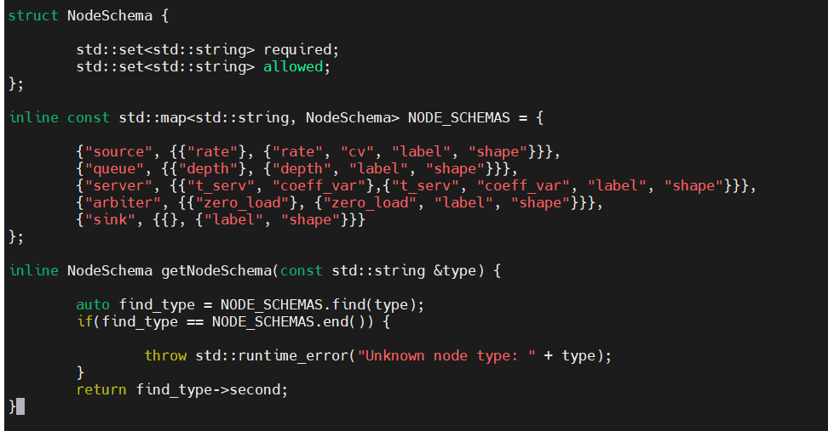


Recap: Proposed Idea for DSL productization
Type Based checking / validation
type attributes defines the role of the node(source,queue, etc.) regardless of node name.
Each type as a required and exclusive set of valid attributes. If extra or wrong ones are given, a compile-time error will be raised.
Define which attributes are required for each node type.
Define which attributes are allowed for each node type
Example:
injector1 [ type=source, rate=0.2, cv=0.85 ]
F2 [ type=source, rate=0.04, cv=0.96 ]
F3 [type=source, size=4 ]

Slide 4
Agenda
Recap
How Parse Tree helps?
Getting Node’s value and Handling Default Attributes.
Getting Source and Destination from edge
Type Based Validation using Symbol Table
Automatic creation of Connector
Future Work

Slide 5
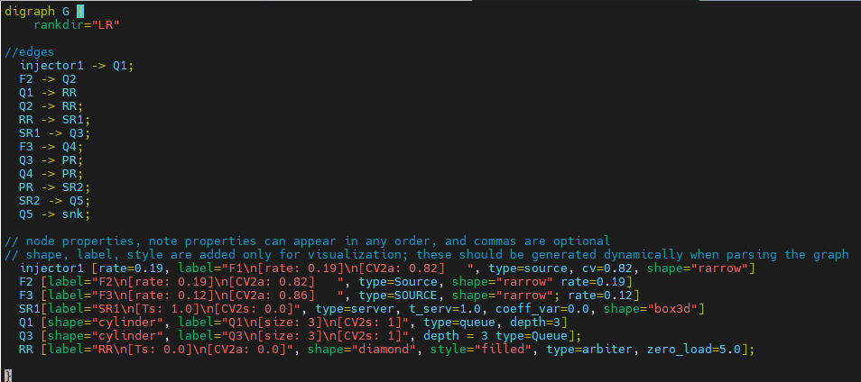
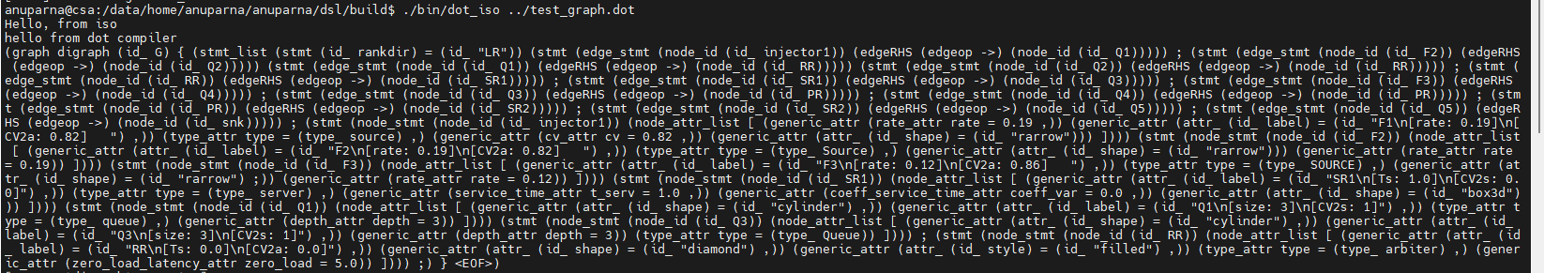
How Parse Tree helps to get value?
Dot
graph
digraph
id_ : G
{
stmt_list
stmt
id_ : rankdir
=
id_ : “LR”
stmt(edge_stmt)
node_id : injector1
edgeRHS
egdeop: ->
node_id: Q1
stmt(edge_stmt) : F2 - >Q2
stmt(node_stmt): injector1
attr: rate = 0.19
attr: label= “F1\n[rate: 0.19]\n[CV2a: 0.82] “
attr: type = source
attr: cv = 0.82
attr: shape = rarrow

Slide 6
Agenda
Recap
How Parse Tree helps?
Getting Node’s value and Handling Default Attributes.
Getting Source and Destination from edge
Type Based Validation using Symbol Table
Automatic creation of Connector
Future Work

Slide 7
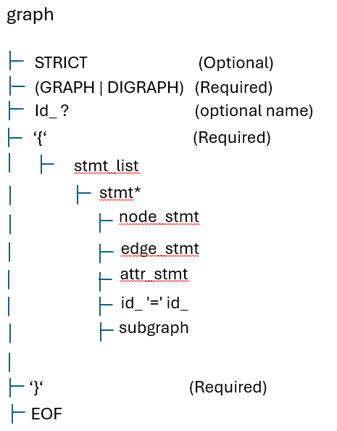
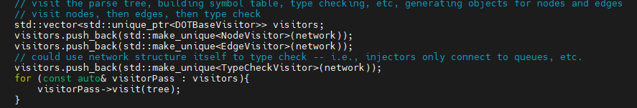
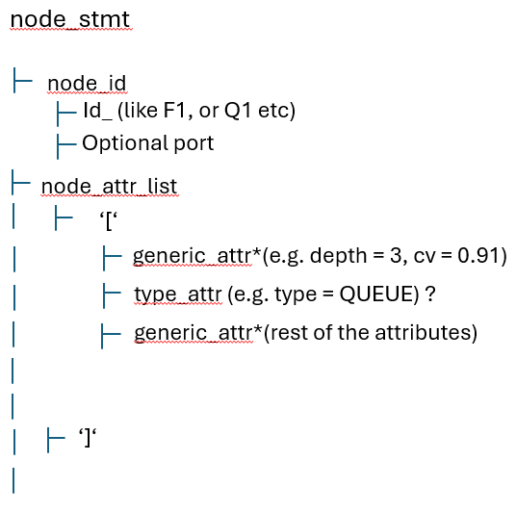
Getting Node’s Value using Parse Tree
Inside translate(&file)
Lexer
Token [like F1, ,[rate=0.19], type=SOURCE,etc]
Parser [Parses the full graph using the DOT grammar]
ParseTree
c
When doing visitorPass visit(tree)
visitNode_stmt() is automatically calls when ANTLR walks the tree and hits
the node_stmt node
We don’t call it manually. Conflict.
Inside NodeVisitor.h
Visit Node_stmt()

Slide 8
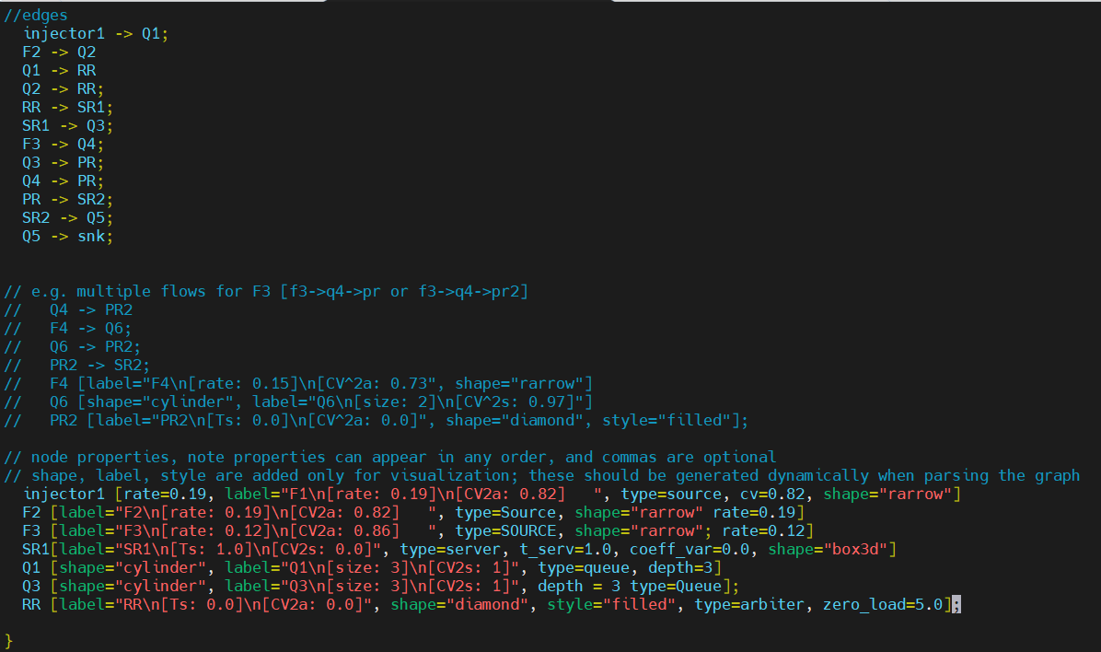
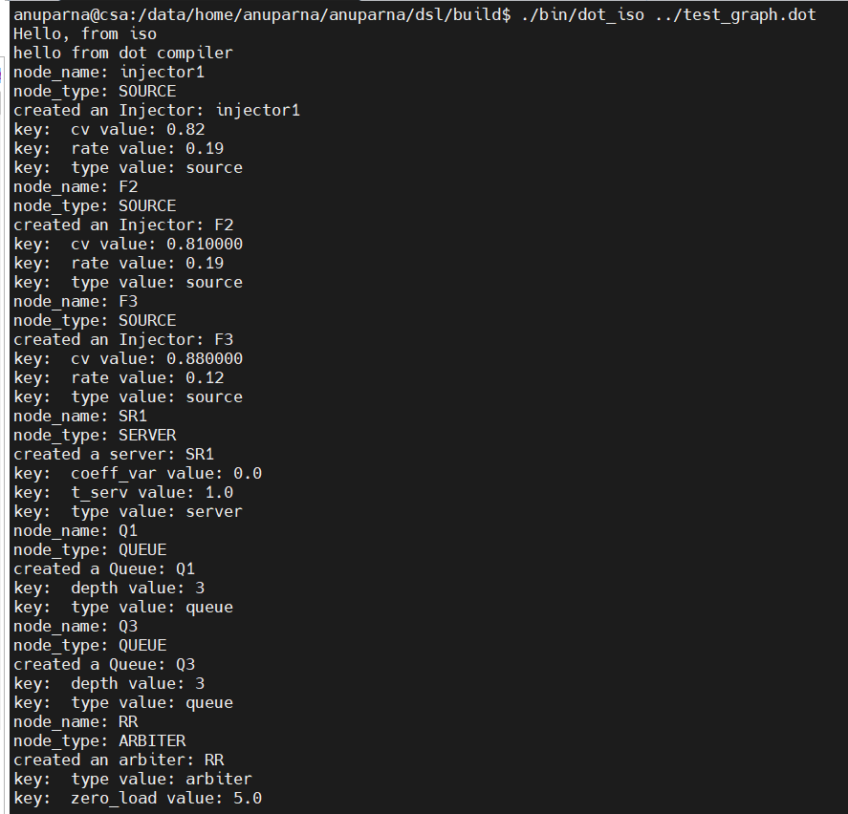
Create Primitives

Slide 9
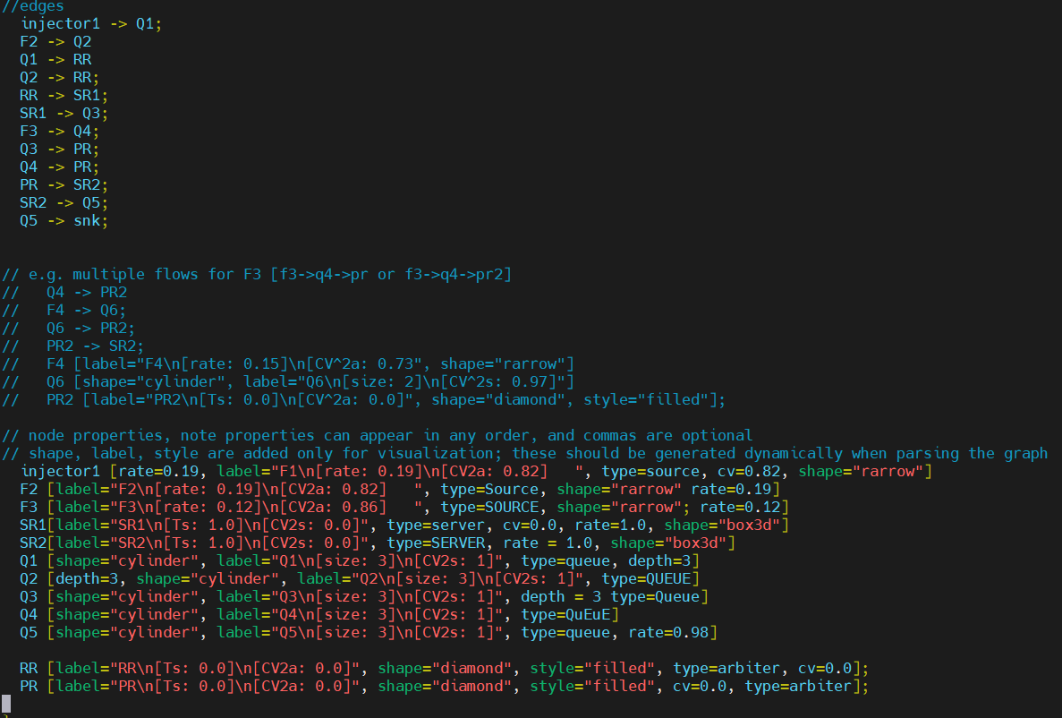
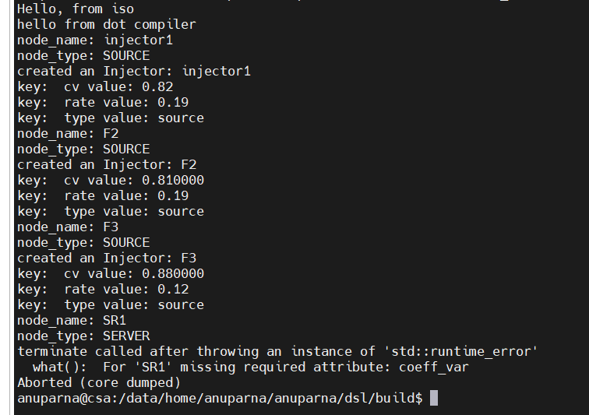
Type Based Validation and Handling Default Attributes
Default cv value (that is 1 – rate) is provided.
For type = SERVER, t_serv & coeff_var is required attribute

Slide 10
Agenda
Recap
How Parse Tree helps?
Getting Node’s value and Handling Default Attributes.
Getting Source and Destination from edge
Type Based Validation using Symbol Table
Automatic creation of Connector
Future Work

Slide 11
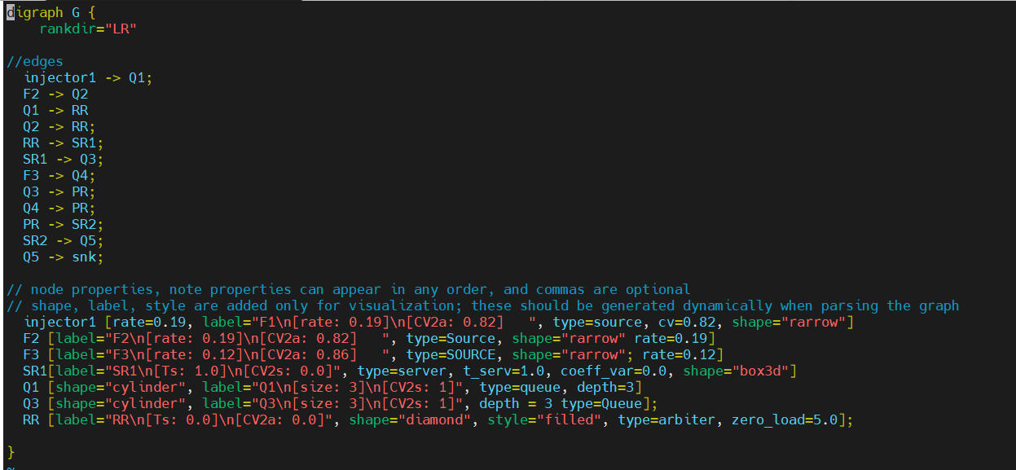
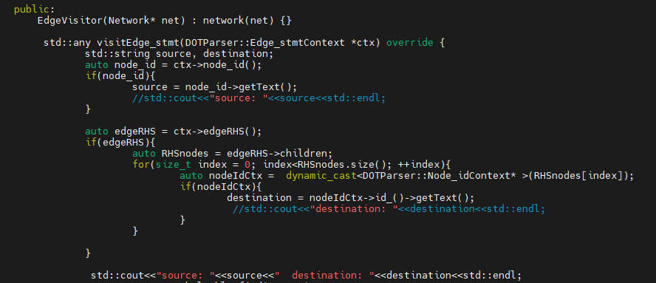
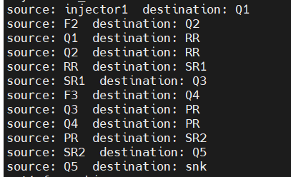
Successfully Generate Source & Destination from Edge
injector1 Q1
Here injector1[ whose type=“SOURCE” ] is connected to Q1
Here Source: injector1 & destination: Q1
Parse Tree
Stmt
(edge_stmt)
node_id : injector1
edgeRHS
egdeop: ->
node_id: Q1
Input file : Test_graph.dot
Output

Slide 12
Agenda
Recap
How Parse Tree helps?
Getting Node’s value and Handling Default Attributes.
Getting Source and Destination from edge
Type Based Validation using Symbol Table
Automatic creation of Connector
Future Work

Slide 13
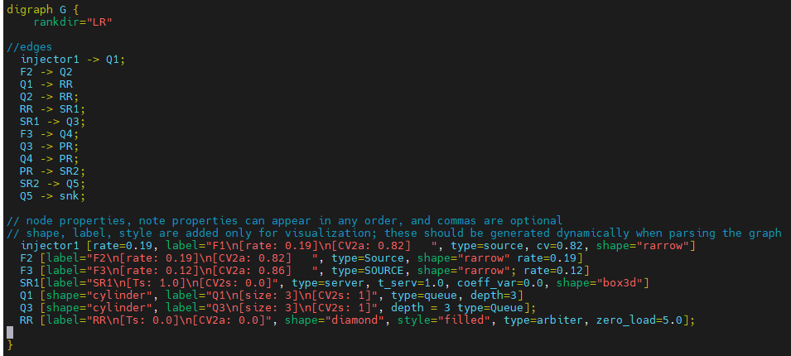
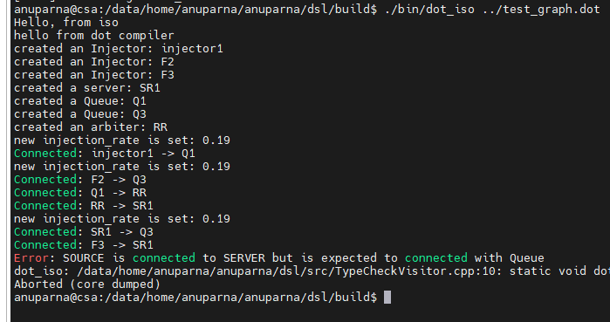
Type Based Validation of Source and Destination
Using SymbolTable
The symbol table will map each node name(like F1, Injector2, RR, Q1, etc.) to its corresponding type(like Injector, Queue, Server, etc.) using the type attribute from the node definition.
This table will be constructed during the node visitation phase .
During the third pass(type-checking), this table will be used to validate each connection(edge) based on the node types.
Rules are defined such as
Injectors can only connect to Queues.
Queues can connect to Server or Arbiters etc.
This third pass is defined in the TypeCheckVisitor.h file
If ( source type is connected to Queue type)
Symbol Table
Injector1 -> Q1
F2 => SOURCE
F3 => SOURCE
Q1 => QUEUE
Q3 => QUEUE
RR => ARBITER
SR1 => SERVER
injector1 => SOURCE
Error

Slide 14
Agenda
Recap
How Parse Tree helps?
Getting Node’s value and Handling Default Attributes.
Getting Source and Destination from edge
Type Based Validation using Symbol Table
Automatic creation of Connector
Future Work

Slide 15
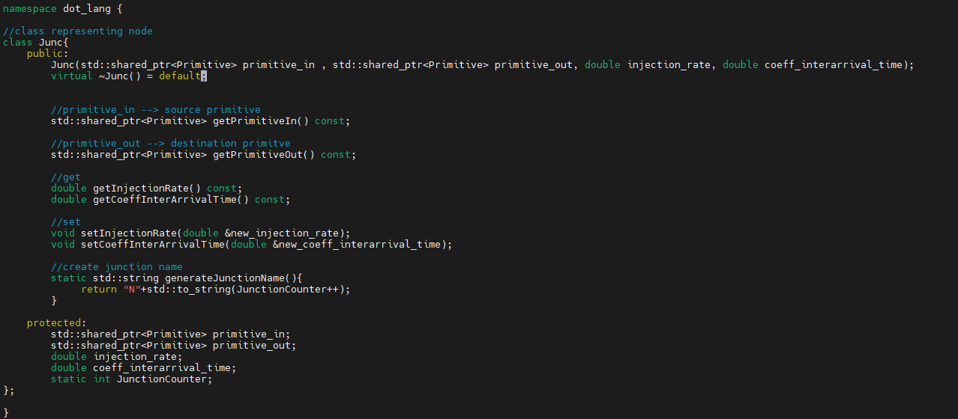
Automatic Junction name creation
Replace Node name(connector between two Primitives) with Automatic created Junction name when it gets source and destination
Junction keeps necessary data which we are using in the time of backtracking, forward pass, and backward pass of analytical model.
Junc is connector between two primitives(source and destination)
generateJunctionName() will generate new Junction name
JounctionCounter is a counter to count Junction.

Slide 16
Agenda
Recap
How Parse Tree helps?
Getting Node’s value and Handling Default Attributes.
Getting Source and Destination from edge
Type Based Validation using Symbol Table
Automatic creation of Connector
Future Work

Slide 17
Future Work
Integration of Analytical Model

